Slide 1
Jacquie’s Used Cars
A Datascope Example

Slide 2

Jacquie’s Used Cars – Some Background
Let's say that I have several old cars that I no longer need, and I decide to sell them.

Slide 3
Jacquie’s Used Cars – Some Background
I'm happy because I sell them quickly and make a little money. I start thinking that I could buy and sell more cars.

Slide 4
Jacquie’s Used Cars – Some Background
So, I decide to start a used car sales business. I call it Jacquie's Used Cars and I run it from my home.

Slide 5
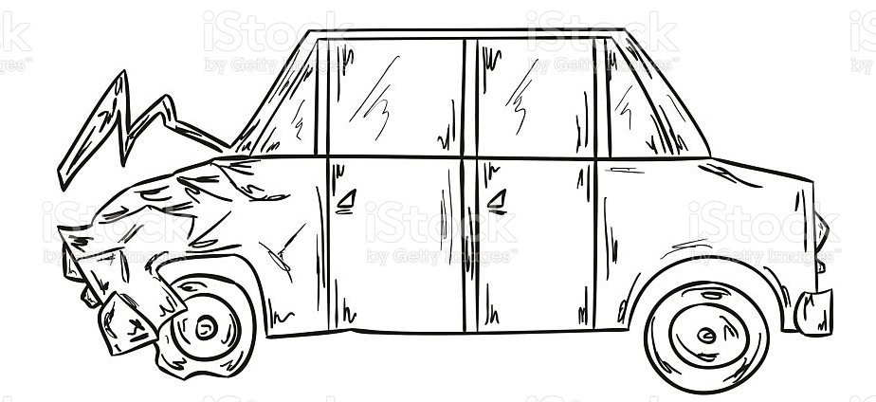
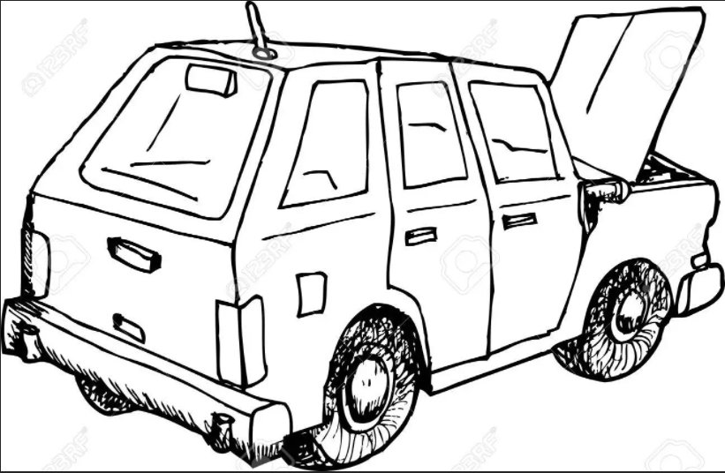


Jacquie’s Used Cars – Some Background
After I sold those first cars, I began looking for other used cars that I could buy and resell. Maybe I had to do some repair work on the body or on the engine. Maybe I just needed to do a thorough cleaning and detail so that they looked really good to a buyer.

Slide 6

Jacquie’s Used Cars – Some Background
I'm happy because I bought them at a really good price. I like looking for cars and buying them and then fixing them up.

Slide 7




Jacquie’s Used Cars – Making $$
Since my goal is to make money doing this, how can I know how much profit I am getting from each car? Since I work alone and from my home, it's pretty easy:
selling price - car cost = profit

Slide 8
Jacquie’s Used Cars – Making $$
Selling price – car cost = profit
What is the cost of the car? That could be a lot of things, but let's just choose 3:
the price I paid + repair cost + cleaning/detail cost = car cost

Slide 9
Jacquie’s Used Cars – Making $$
Selling price – car cost = profit
Here's an example: Let's say I buy a used 2006 Honda CRV-EX with 80,000 miles on it for $3,500 from someone in my neighborhood. I fix the brakes at a cost of $700 and I do a thorough detail (wash) of the interior and exterior of the car at a cost of $200. So, I have invested $4,400 in this car. I sell it for $7,000.
$7,000 – $4,400 = $2,600
I make $2,600 from this car.

Slide 10
Jacquie’s Used Cars – Vehicle Information
In addition to keeping track of the cost of the car, I also need to remember all the information about each car:
what kind of car it is
how many miles the car has
how old the car is
whether it has ever been in an accident
Other things like that

Slide 11



Jacquie’s Used Cars – Information Overload
When I first started the business, I only had a couple of cars to sell, so I could keep track of everything in my head.
1976 Datsun 210
250,000 miles
2 accidents!
1964 Studebaker
150,000 miles
No accidents!
1987 Toyota Corolla
187,000 miles
1 accidents!

Slide 12






Jacquie’s Used Cars – Information Overload
As I deal with more and more cars, it becomes too much to keep in my head, so I have to start keeping track in a different way, so I start using a spiral notebook or an Excel spreadsheet.

Slide 13
Jacquie’s Used Cars – Information Overload
But business is going really well, and I have a lot of sales and customers call me all the time, wondering if I have a certain car and how much it costs, etc. I am so busy that I need to hire some employees. I need some people to do repairs and the detailing and some sales.

Slide 14
Jacquie’s Used Cars – Information Overload
I want to know which employee does:
an engine repair
a body repair
Detailing job
I want to be a good employer, so I want to offer:
Benefits after a 6-month probation period
Bonuses for every employment anniversary
Evaluations every 6 months
Looking towards the future, I might want to offer:
Profit-sharing
Discounts on cars

Slide 15





Jacquie’s Used Cars – I need a database!
For sure now, there is way too much information to keep track of in my head or in a spiral notebook or with an Excel spreadsheet. It is clear that I need a database!

Slide 16
Jacquie’s Used Cars – I need a database!
Based on the information above, what is the scope of the Jacquie's Used Cars database?
What does Jacquie need to be able to do?
What will the database need to include to work for her?
Are there constraints?
Also, can you create a 1-sentence history of Jacquie’s Used Cars?
Don’t copy and paste – just put the history into your own words

